Slide 1
Epidermolysis Bullosa
Author
Institutional Affiliation
Instructor
Course code
Date of submission

Slide 2
Introduction
Epidermolysis Bullosa, also known as E.B. is generally an inherited connective tissue disease (Dharma et al. 2001).
Epidermolysis bullosa (E.B.) is a group of inherited diseases that are usually characterized by blistering lesions on the surface of the skin and the mucous membranes.
Usually, E.B. can occur anywhere in the body but is mostly found around the regions of frictions and minor traumas such as the feet and hands.
Notes:
Epidermolysis bullosa consists of a group of rare generally determined skin infection that blisters the skin with little or no apparent trauma.
Observably, the fragility of the skin and mucosa membranes can occur anywhere in the body, however it mostly affects the feet and the hands.

Slide 3
However, in some rare types of E.B., blisters may occur on the esophagus, respiratory tract, and even the stomach.
Generally, these areas do not experience any significant amounts of friction.
In a sense, the condition caused by E.B. causes the skin to be very fragile and thus blisters easily (Fine, 2016).
As indicated above, minor injuries and frictions on the already fragile skin result in blisters and skin erosions
Notes:
As observed by Fine (2006), EB is mainly caused by the defects in the structural proteins within the epidermis.
In essence, these defects generally results in reduced adhesion within the cellular structures of the epidermis.

Slide 4
Types of Epidermolysis bullosa
Generally, there are three types of E.B. The National Health Service, the U.K. has indicated that there are many variants of these main types, each externalizing slightly varying symptoms (Varki et al. 2007).
In this sense, the organization has classified over 27 variants of the disease.
In a sense, each of these classification is done depending on the level of blistering of the skin.
Notes:
EB has been classified in 3 major divisions depending on the mode of inheritance, location of lesions, and clinical features.
Generally, these classifications include; EB simplex (EBS), junctional EB (JEB), and dystrophic EB (DEB).

Slide 5
Epidermolysis bullosa simplex
This disorder blisters the upper layer of the skin. Observably, this represents the most common type of the disease, accounting for over 70% of the cases.
Notes:
Caused by defects in the genes responsible for the formation of keratin, consequently resulting blisters within the epidermis.

Slide 6
Dystrophic epidermolysis bullosa (DEB)
Blistering occurs below the basement membrane zone in the upper part of the dermis accounting for over 25% of the cases.
Notes:
Caused by mutations of collagen VII that results in dermal blisters below the basal lamina within the papillary dermis.

Slide 7
Junctional epidermolysis bullosa (JEB)
In this type, blistering occurs between the two layers of the skin, i.e., the dermis and the epidermis. This layer of the skin is referred to as the basement membrane zone.
Even though it accounts for only 5% of all the occurrences, it is considered one of the most severe forms of the disease.
Notes:
Caused by defects in the basement membrane, specifically laminins, consequently resulting in blisters in the lower membrane of the epidermis.

Slide 8
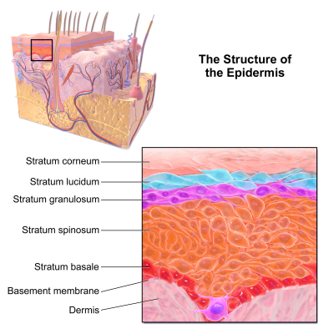
An image showing the structure of the epidermis

Slide 9
Causes
Observably, E.B. is an inherited condition.
This means that individuals with this disorder either have one or two of the mutated E.B. genes.
It is important to note that E.B. occurs immediately at birth or shortly after birth.
Ten hereditary genes are associated with the different types of the disease. Individuals with E.B. are said to have received the faulty genes from their parents (Golchin et al. 2019).
It is noted that the faulty genes determine the inherited E.B. character, consequently resulting in abnormalities in the skin.
Notes:
EB mainly occurs due to defects in the cellular structural proteins within the epidermis.
These defects cause abnormalities in the genes encoding the various proteins.

Slide 10
Similarly, these genes also influence the formation of proteins in the skin, including keratin and collagen.

Slide 11
Frequency
It is noted that all the types and subtypes of E.B are rare
It is approximated that E.B. has affected close to 3 million people globally.
It is indicated that the disorder affects both males and females alike.
In some situations, the disease doesn’t become apparent until an individual reaches adulthood before it is detected (Dharma et al. 2001).
However, milder cases of the disease can be visible when a child crawls, walks, and or even runs.
Notes:
The prevalence and occurrence of E.B is generally rare.
Globally, the condition has affected close to 3 million individuals, both males and females alike.
In some situations, the disease does not externalize until adulthood.

Slide 12
Symptoms of E.B.
Symptoms exhibited by individuals significantly differ from person to person ranging from simple blistering of the hands, knees, and elbows to widespread blistering of the body that may consequently result in vision loss besides other severe medical complications.
Researchers have classified Epidermolysis bullosa into three major divisions. These divisions are primarily based on the inheritance patterns and the types of features presented by the individuals with the condition.
Notes:
Even though symptoms presented may differ from one person to the other, it is important to understand that the primary symptom of EB is the presence of lesions on the skin.
Lesions occur in the form of blisters of open wounds occurring randomly across the body.
Individuals presenting EB symptoms usually have their lesions and blisters mostly around the regions of constant frictions.

Slide 13
E.B. is mostly noticed through blisters on the hands and feet due to friction on the already fragile skin.
In mild forms of E.B., wounds may heal even without scarring; however, the wound area may thicken, especially on the soles and palms.
It is imperative to note that even though blistering is primarily associated with E.B., in mild cases, blistering is often limited to the hands, feet, and knees but may, however, spread to the other regions of the body in severe cases.
Notes:
Blisters may be visible on the hands and the feet in most occasions, however in severe occasions, blisters may form anywhere on the body.

Slide 14
Another symptom exhibited by affected people is the deformity of fingernails and toenails.
Other than observable blisters, abnormal toenails and fingernails are the only indications of the condition.
Notes:
Deformity of toenails and fingernails is also a symptom in some individuals.
It is however important to note that in severe cases, individuals may present the above symptoms besides impaired breathing and genitourinary problems.

Slide 15
Diagnosis
It is easier to identify E.B., especially in regions where blisters have formed within the skin.
Diagnosis usually involves the use of a microscope to observe the lesions in very mild situations.
Also, healthcare professionals can perform gene analysis to determine the possibility of having the disorder.
Notes:
Based on clinical presentation, doctors may perform biopsy and immunofluorescence microscopy of the skin to determine the level of severity of the condition.
Also, performing gene analysis can help professionals in determining the history of the family of EB.

Slide 16
Treatment
Currently, there exists no cure for the disorder.
However, pain-relieving is the only available remedy and is considered the current treatment plan for the disorder. The blisters are bandaged with special bandages.
However, no medication has proven to improve epidermis deadhesion.
Notes:
Currently, there exists no treatment plan for the disorder. However, most of the treatment plans revolve around pain relieving procedures.
Also, special bandages are used to cover blisters and wounds from germs and subsequent entry of germs.

Slide 17
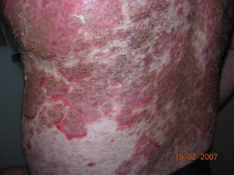
An image showing blisters on the human skin

Slide 18
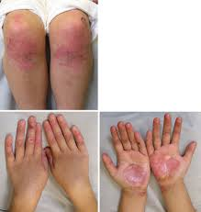
An image showing the most affected parts of the body

Slide 19
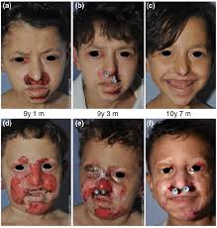
An image showing a child with deformed teeth

Slide 20
References
Golchin, A., Farahany, T. Z., Khojasteh, A., Soleimanifar, F., & Ardeshirylajimi, A. (2019). The clinical trials of mesenchymal stem cell therapy in skin diseases: an update and concise review. Current stem cell research & therapy, 14(1), 22-33.
Dharma, B., Moss, C., McGrath, J. A., Mellerio, J. E., & Ilchyshyn, A. (2001). Dominant dystrophic epidermolysis bullosa presenting as familial nail dystrophy. Clinical and experimental dermatology, 26(1), 93-96.

Slide 21
Fine, J. D. (2016). Epidemiology of inherited epidermolysis bullosa based on incidence and prevalence estimates from the National Epidermolysis Bullosa Registry. JAMA dermatology, 152(11), 1231-1238.
Varki, R., Sadowski, S., Uitto, J., & Pfendner, E. (2007). Epidermolysis bullosa. II. Type VII collagen mutations and phenotype-genotype correlations in the dystrophic subtypes. Journal of medical genetics, 44(3), 181-192.

